Slide 1


BANK ACCOUNT FRAUD DETECTION
ADVANCED PYTHON ANALYTICS WITH XGBOOST MODEL
DATA ANALYTICS LIFE-CYCLE IMPLEMENTATION
ADTA 5340 - METHODS FOR DISCOVERY AND LEARNING WITH BIG DATA
GROUP 4
TEAM MEMBERS:
ASHLEY CHESSER - 11797090
SANA AMBREEN - 11886060
SEANA MUTINDA ZEYHLE - 11845709
From Raw Data to Business Insights
DATE: 25/07/2025

Slide 2
TABLE OF CONTENTS
EXECUTIVE SUMMARY
DATA CLEANING & PREPROCESSING
FEATURE ENGINEERING
EXPLORATORY DATA ANALYSIS (EDA)
MODEL TRAINING & VALIDATION (XGBOOST)
MODEL PERFORMANCE EVALUATION
CORRELATIONAL ANALYSIS
BUSINESS IMPACT ASSESSMENT
RISK PATTERNS & RECOMMENDATIONS
FRAUD PREVENTION STRATEGIES

Slide 3




EXECUTIVE SUMMARY
The Bank Account Dataset comprises of bank account opening fraud tabular datasets. The purpose of this dataset is to predict the customers having a high probability of fraud while opening a bank account. We will design a classification model to classify the customers as fraudulent or non-fraudulent.
Bank Account Opening Fraud Detection:
Dataset: 1,000,000 bank account applications with 32 features
Objective: Predict fraudulent applications during the account opening process
Model: XGBoost Classifier with hyperparameter optimization
Key Result: 80% recall for fraud detection with optimized business impact
Critical Business Problem:
Fraud rate: 1.1% (11,029 fraudulent cases out of 1M applications)
High-stakes decision making: False negatives cost significantly more than false positives
Need for real-time fraud detection during account opening process
Data Source: Kaggle, Github
Page 3

Slide 4
DATA CLEANING AND PREPOCESSING
Data Integrity
No missing values - Complete dataset
Invalid negative values in 10 critical columns were replaced with column medians
Extreme outliers detected in 15 numerical features capped at 99th percentile to reduce skewness
Data types optimized for modeling efficiency
Feature Categories
Personal information (age, income, employment)
Address history and stability
Device and session characteristics
Banking behavior patterns
Risk scoring metrics
Key Impact
Clean, reliable dataset foundation for accurate model training.
Page 4

Slide 5
FEATURE ENGINEERING STRATEGY
Created 3 high-impact features that enhanced the model's ability to detect
sophisticated fraud patterns:
Credit-to-Income Ratio
2. Total Distinct Emails
3. Long Address Flag
Formula: proposed_credit_limit / (income + 1e-5)
Identifies suspicious credit requests relative to income
mean=1498.38, std=2382.41
Combines device and birth date email patterns
Flags potential identity manipulation
mean=10.49, std=4.94
Binary indicator for residence >200 months
Captures address stability patterns
12,113 flagged cases (11.2%)
Page 5

Slide 6
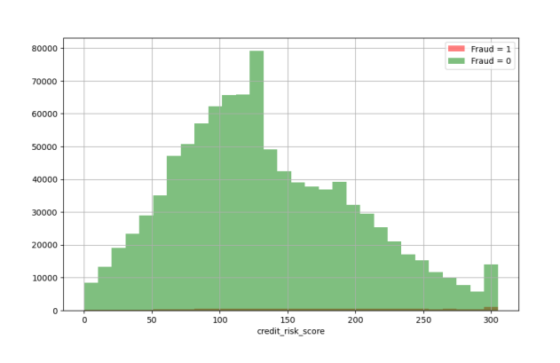
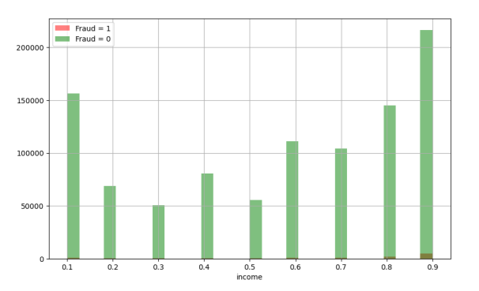
EXPLORATORY DATA ANALYSIS (EDA)
Key Insights
Non-fraudulent cases dominate across all income levels
Fraud cases concentrated in higher income brackets (0.8-0.9 range)
Most records have credit risk score between 50-200
Highest Income Bracket with Fraud
Most observations concentrated in lower income brackets and a notable spike in the highest income range.
Page 6

Slide 7
XGBOOST IMPLEMENTATION APPROACH
Model Justification
Best performance in terms of Accuracy and overfitting for fraud classification problems compared to Decision Tree and Random Forest.
Handles outliers and noisy features effectively than a Decision Tree.
Provides clear feature importance scores helpful in detecting frauds more efficiently.
Hyperparameter Optimization
RandomizedSearchCV with 25 parameter combinations
3-fold cross-validation for robust evaluation
75 total model configurations tested
Class Imbalance Handling
Scale_pos_weight: 89.86 (ratio of non-fraud to fraud cases)
Focus on recall optimization for fraud detection
Feature Preparation: 51 final features after one-hot encoding of categorical variables
Cross-Validation Result
78.87% recall score
Consistent performance across validation folds
Page 7

Slide 8
MODEL TRAINING & VALIDATION
Optimal Hyperparameters Found:
Max Depth: 3
Learning Rate: 0.01
N_Estimators: 600
Subsample: 0.8
Colsample_bytree: 0.8
Cross-Validation Result:
78.87% recall score
Consistent performance across validation folds
Page 8

Slide 9
MODEL PERFORMANCE EVALUATION
Key Metrics
Recall (Fraud Detection): 80%
Precision: 5%
Overall Accuracy: 81%
False Positives: 56,112 (manageable false alarms)
False Negatives: 675 (critical missed frauds)
Confusion-Matrix Results
 | Predicted: Negative (0) | Predicted: Positive (1)
Actual: Negative (0) | 240,563 | 56,112
Actual: Positive (1) | 675 | 2,650
Page 9

Slide 10
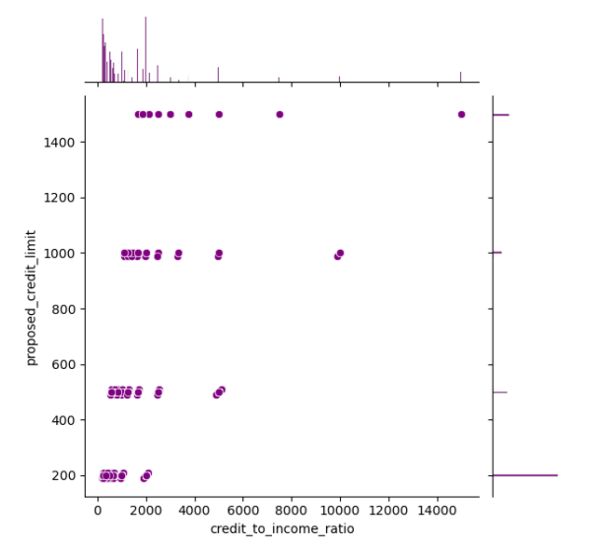
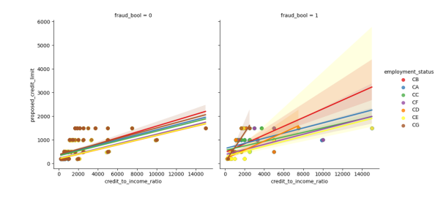
CORRELATIONAL ANALYSIS REPORT
Credit-to-Income vs Credit Limit
Legitimate cases: Lower ratios with higher approved limits
Fraudulent cases: High ratios even for modest credit requests
No direct correlation between the variables (important for model feature independence)
Employment Status Impact
Different employment categories show distinct fraud patterns when analyzed with income ratios.
Page 10

Slide 11
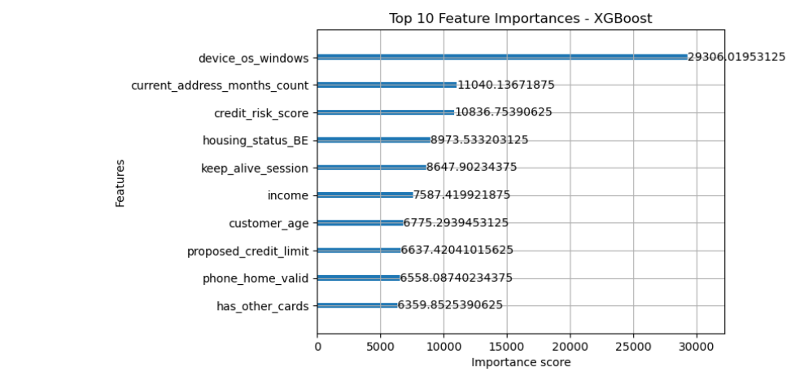
FEATURE IMPORTANCE ANALYSIS
Strategic Insights
This shows that devices with windows OS are highly indicative of fraud.
Less stability at current address correlates with fraud risk.
Credit risk score plays an important role in identifying frauds.
Income level can discriminate between fraud and non fraud profiles.
Age contributes moderately to fraud detection.
Customers with multiple cards show different fraud patterns.
Page 11

Slide 12
BUSINESS IMPACT ASSESSMENT
Current Model Performance Translations
Daily Application Volume (assuming 1,000 applications/day):
Expected frauds: 11 cases
Model catches: 9 fraud cases (80% recall)
False alarms: 188 cases (based on current precision)
Missed frauds: 2 cases
Confusion-Matrix Results
 | Predicted: Negative (0) | Predicted: Positive (1)
Actual: Negative (0) | 240,563 | 56,112
Actual: Positive (1) | 675 | 2,650
Cost-Benefit Considerations
High recall critical: Missing fraud costs significantly more than manual review
False positives manageable with efficient review process
Page 12

Slide 13
RISK PATTERNS
RECOMMENDATIONS
RED FLAGS
Tier 1: Automated Flagging
High-Risk Application Profiles
Deploy model for real-time scoring during application process
Automatic holds for scores above threshold
Prioritize manual review queue by risk score
Technology Indicators:
Windows OS usage (highest risk factor)
Multiple distinct emails from same device
Unusual session behavior patterns
Tier 2: Enhanced Verification
Additional documentation for high-risk categories
Device fingerprinting for Windows users
Address verification for short-tenure applicants
Behavioral Indicators:
High credit-to-income ratios
Short current address tenure
Specific employment categories (CE, CC)
High proposed credit limits relative to the profile
Tier 3: Monitoring and Feedback
Track false positive patterns for model refinement
Regular model retraining with new fraud patterns
Page 13

Slide 14
FRAUD PREVENTION STRATEGIES
Application Process Enhancements
Multi-factor authentication for high-risk profiles
Real-time address verification
Enhanced employment verification for specific categories
Risk-Based Workflows
Differentiated approval processes by risk score
Graduated verification requirements
Automated documentation requests for suspicious patterns
Technology Safeguards
Device reputation scoring
Email domain risk assessment
Behavioral analytics integration
Page 14

Slide 15
REFRENCE LIST
1. Feedzai. (2022). Bank account fraud dataset datasheet [PDF]. GitHub. https://github.com/feedzai/bank-account-fraud/blob/main/documents/datasheet.pdf
2. Jesus, S. G. P. (2022). Bank account fraud dataset (NeurIPS 2022) [Data set]. Kaggle. https://www.kaggle.com/datasets/sgpjesus/bank-account-fraud-dataset-neurips-2022/data
Page 15

Slide 16

THANK YOU!
hello@reallygreatsite.com

